Slide 1
Practical

Slide 2
Experiment: Determine the surface tension of a given liquid at room temp using stalagmometer.
Apparatus and Chemicals: Stalagmometer, specific gravity bottle, distilled water, experimental liquid.

Slide 3
Theory:
In the drop number method, the number of drops formed by equal volumes of two liquid is counted. If m₁ and m₂ is the mass of one drop of each of the liquid having densities d₁ and d₂ respectively. If n₁ and n₂ is the number of drops formed by volume V of the two liquids, then their surface tensions are related as
ɣ₁/ɣ₂= (d₁/d₂)*(n₂/n₁)
One of the liquid is water its surface tension and density are known. Then the surface tension of the given liquid can be calculated.

Slide 4
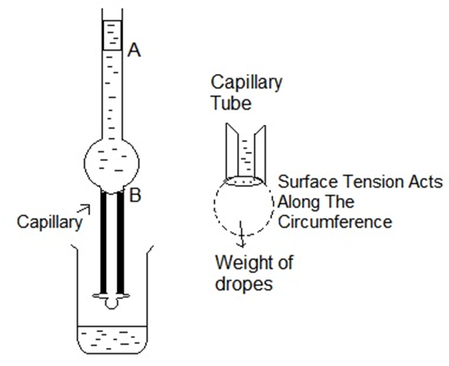

Slide 5
Procedure
1. Clean the stalagmometer with chromic acid mix, wash with water and dry it
2. Immerse the lower end of the stalagmometer in distilled water and suck the water 1-2 cm above mark X.
3.Adjust the rate so that 10-15 drops fall per minute

Slide 6
4. Clamp the stalagmometer allow the water drops to fall and start counting the number of drops when the meniscus crosses the upper mark A and stop counting when the meniscus passes mark B
5. Repeat the exercise to take three to four readings.
6. Rinse the stalagmometer with alcohol and dry it.
7. Suck the given liquid in the stalgmometer and count the drops as in case of water.
8. Take a clean dry gravity bottle and weighs it with water as well as with liquid.
9. Note the temp of water taken in a beaker.

Slide 7
Observations:
Room temp=t ⁰C
Density of water=d_{w}
Surface tension of water=ɣ₁ dynes/cm
 | Number of drops | Mean
Water | 1 2 3 | n1
Liquid | 1 2 3 | n2

Slide 8
Weight of empty specific gravity bottle=w₁
Weight of specific gravity bottle+water=w₂
Weight of empty sp.gravity bottle+liquid=w₃
Weight of water= (w₂-w₁)
Weight of liquid= (w₃-w₁)
Calculations:
Density of the liquid d1= (w₃-w₁)/(w₂-w₁) x d_{w}
Surface tension of liquid
ɣ₁/ɣ₂= (d₁/d₂)x (n₂/n₁)

Slide 9
Result
The surface tension of liquid is ………dynes/cm.

